Slide 1
CONTAINMENT ZONE ALERTING APPLICATION
LITERATURE SURVEY

Slide 2
TEAM DETAILS :
TEAM LEADER : Allen lubin
TEAM MEMBERS : Bangarulakshmanan
Ganeshan
Dhinesh kumar

Slide 3
ABOUT – PROJECT :
THIS APPLICATION IS INTENDED TO PROVIDE INFORMATION ABOUT CONTAINMENT ZONES IN A PARTICULAR REGION BY ALERTING PEOPLE, THROUGH CONTINUOUS MONITORING OF AN INDIVIDUAL'S LOCATION.
KEY BENEFITS OF THE APPLICATION ARE MONITORING PEOPLE'S ACTIVITY AND ALERTING THEM OF THEIR SAFETY MOVEMENTS.

Slide 4
ABOUT – PROJECT :
THE PRIMAY PURPOSE OF THE APP IS TO ENABLE HEALTH SERVICES TO IMPROVE THE SPEED AND EFFECTIVENESS OF CONTACT TRACING AND TO MAP AND PREDICT THE SPREAD OF PARTICULAR DISEASE.
THIS TRACKER APP OFFERS REAL TIME , DEATAILED,INTERACTIVE VISUALIZATIONS THAT HAVE THE POTENTIAL TO SHAPE DECISION MAKING AND INFORM ABOUT PANDEMIC SITUATIONS TO PEOPLE’S.

Slide 5
ABOUT – PROJECT :
THE PROJECT AIMS AT BUILDING AN APPLICATION THAT PROVIDES INFORMATION ABOUT THE CONTAINMENT ZONES OF A PARTICULAR REGION BY CONTINUOUSLY MONITORING AN INDIVIDUAL'S LOCATION.
LOCATION OF THE INDIVIDUAL MUST BE STORED IN THE DATABASE. ALERTS ARE SENT USING THE NOTIFICATION SERVICE.

Slide 6
LITERATURE SURVEY :
TITLE | DETAILS | FLOW | TOOLS | LINKS
TRACE TOGETHER APP | TRACE TOGETHER IS A DIGITAL SYSTEM IMPLEMENTED BY THE GOVERNMENT OF SINGAPORE IN RESPONSE TO THE COVID – 19 PANDEMIC | COLLECTING &REPRESENTING GPS POINTS. BLUE TRACE ASSESSING RISK & NOTIFYING USERS | GPS BLUETOOTH LOCATION API GATEWAY CLOUD SERVER | https://tracetogether.zendesk.com/hc/en-sg/

Slide 7
LITERATURE SURVEY :
TITLE | DETAILS | TECH | TOOLS | LINKS
CONTACT TRACING MOBILE APPS FOR COVID 19 | THIS PAPER IS ABOUT THE MOBILE PHONE APP THAT IS DESIGNED TO ASSIST HEALTH OFFICIALS IN TRACKING & MONITORING DOWN EXPOSURE AFTER AN INFECTED INDIVIDUAL IS IDENTIFIED. | CLOUD COMPUTING DATA ANALYTICS MACHINE LEARNING | FLASK HTML DOCKER PYTHON API GATEWAY | https://arxiv.org/abs/2003.11511

Slide 8
LITERATURE SURVEY :
TITLE | DETAILS | FLOW | TOOLS | LINKS
ASSESSING DISEASE EXPOSURE RISK WITH LOCATION DATA. - MAR 2020 | IMPLEMENTING DIGITAL CONTACT TRACING SOLUTIONS TO STEM THE SPREAD OF INFECTIONS DISEASE LIKE COVID 19 | COLLECTING &REPRESENTING GPS POINTS. DETECTING POINTS OF CONTACT USING PSI. ASSESSING RISK & NOTIFYING USERS. | GPS PRIVATE SET INTERSECTION BLUTOOTH DATA ANALYTIC MECHANISMS | //arxiv.org/pdf/2003.14412.pdf

Slide 9
LITERATURE SURVEY :
TITLE | DETAILS | SECTION | TOOLS | LINKS
AAROGYA SETU APP | IT IS A COVID – 19 TRACKING APP THAT USES GPS AND BLUETOOTH FEATURES OF SMART PHONES TO TRACK INFECTION. | USER STATUS SELF ASSESS UPDATES CONTAINMENT ZONES | OPEN API API GATEWAY AWS LAMBDA AWS CLOUD BLUETOOTH GPS | https://www.aarogyasetu.gov.in/

Slide 10
CONTACT TRACING APPS :
INDIA:
AAROGYA SETU
TRACY
USA :
CoEpi
COVID WATCH
COVID SAFE PATHS
SINGAPORE :
TRACE TOGETHER
SOUTH KOREA :
CORONO 100m
CHINA:
ALIPAY HEALTH CODE
WECHAT
UK :
COVID SYMPTOM TRACKER
FRANCE :
STOP COIVD
POLAND :
PROTEGO
ICELAND :
RANKING C-19

Slide 11
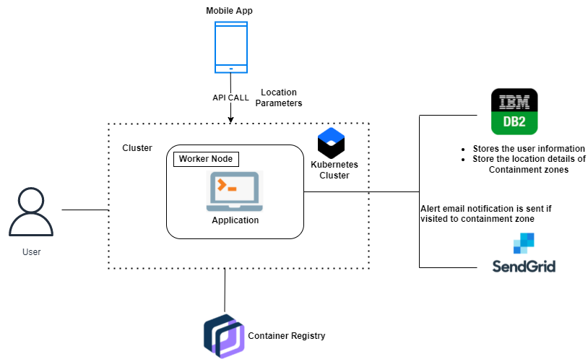
TECHNICAL ARCHITECTURE :

Slide 12
T H A N K
YOU

